Slide 1


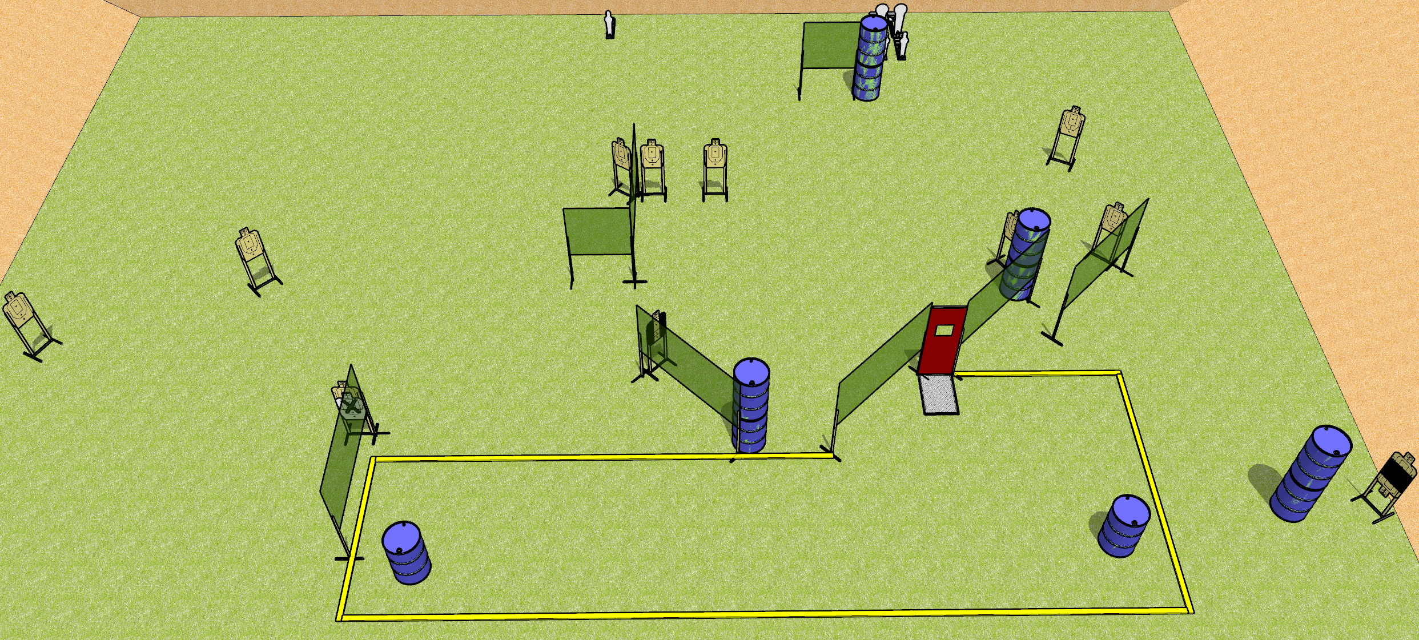
 | Dothan Gun Club – USPSA Match Get Some Course Designer : Drew Coleman
START POSITION : Anywhere in the shooting area, back straight, wrists above shoulders.
GUN READY CONDITION : Firearm placed on either barrel in the shooting area. Firearm is loaded, unsupported, safety on. |  | SCORING: Comstock, 29 rounds TARGETS: 12 paper, 5 Steel SCORED HITS: Best 2 on paper, steel until down START-STOP: Audible, last shot RULES:
STAGE PROCEDURE: Engage targets as they become available from within the fault lines.

Slide 2
Get Some
Written Stage Briefing
Get Some is a 29 round, 155 point, Comstock field course. There are twelve USPSA targets, three mini poppers, and two colt poppers. The best two hits on paper will score, and steel must fall to score. The start signal is audible.
Start position is anywhere in the shooting area, back straight, wrists above shoulders. Handgun or PCC is loaded, safety on, laying flat on either barrel in the shooting area. Muzzle is pointed down range.
On start signal, engage targets as they become available from within the shooting area.

